Slide 1

Storytelling with Data
GAMECO.
Muhammad Abdulkayyum Muttaki​

Slide 2

Agenda
Introduction
Regional Sales
Competing Regions
Most played games
Summary

Slide 3
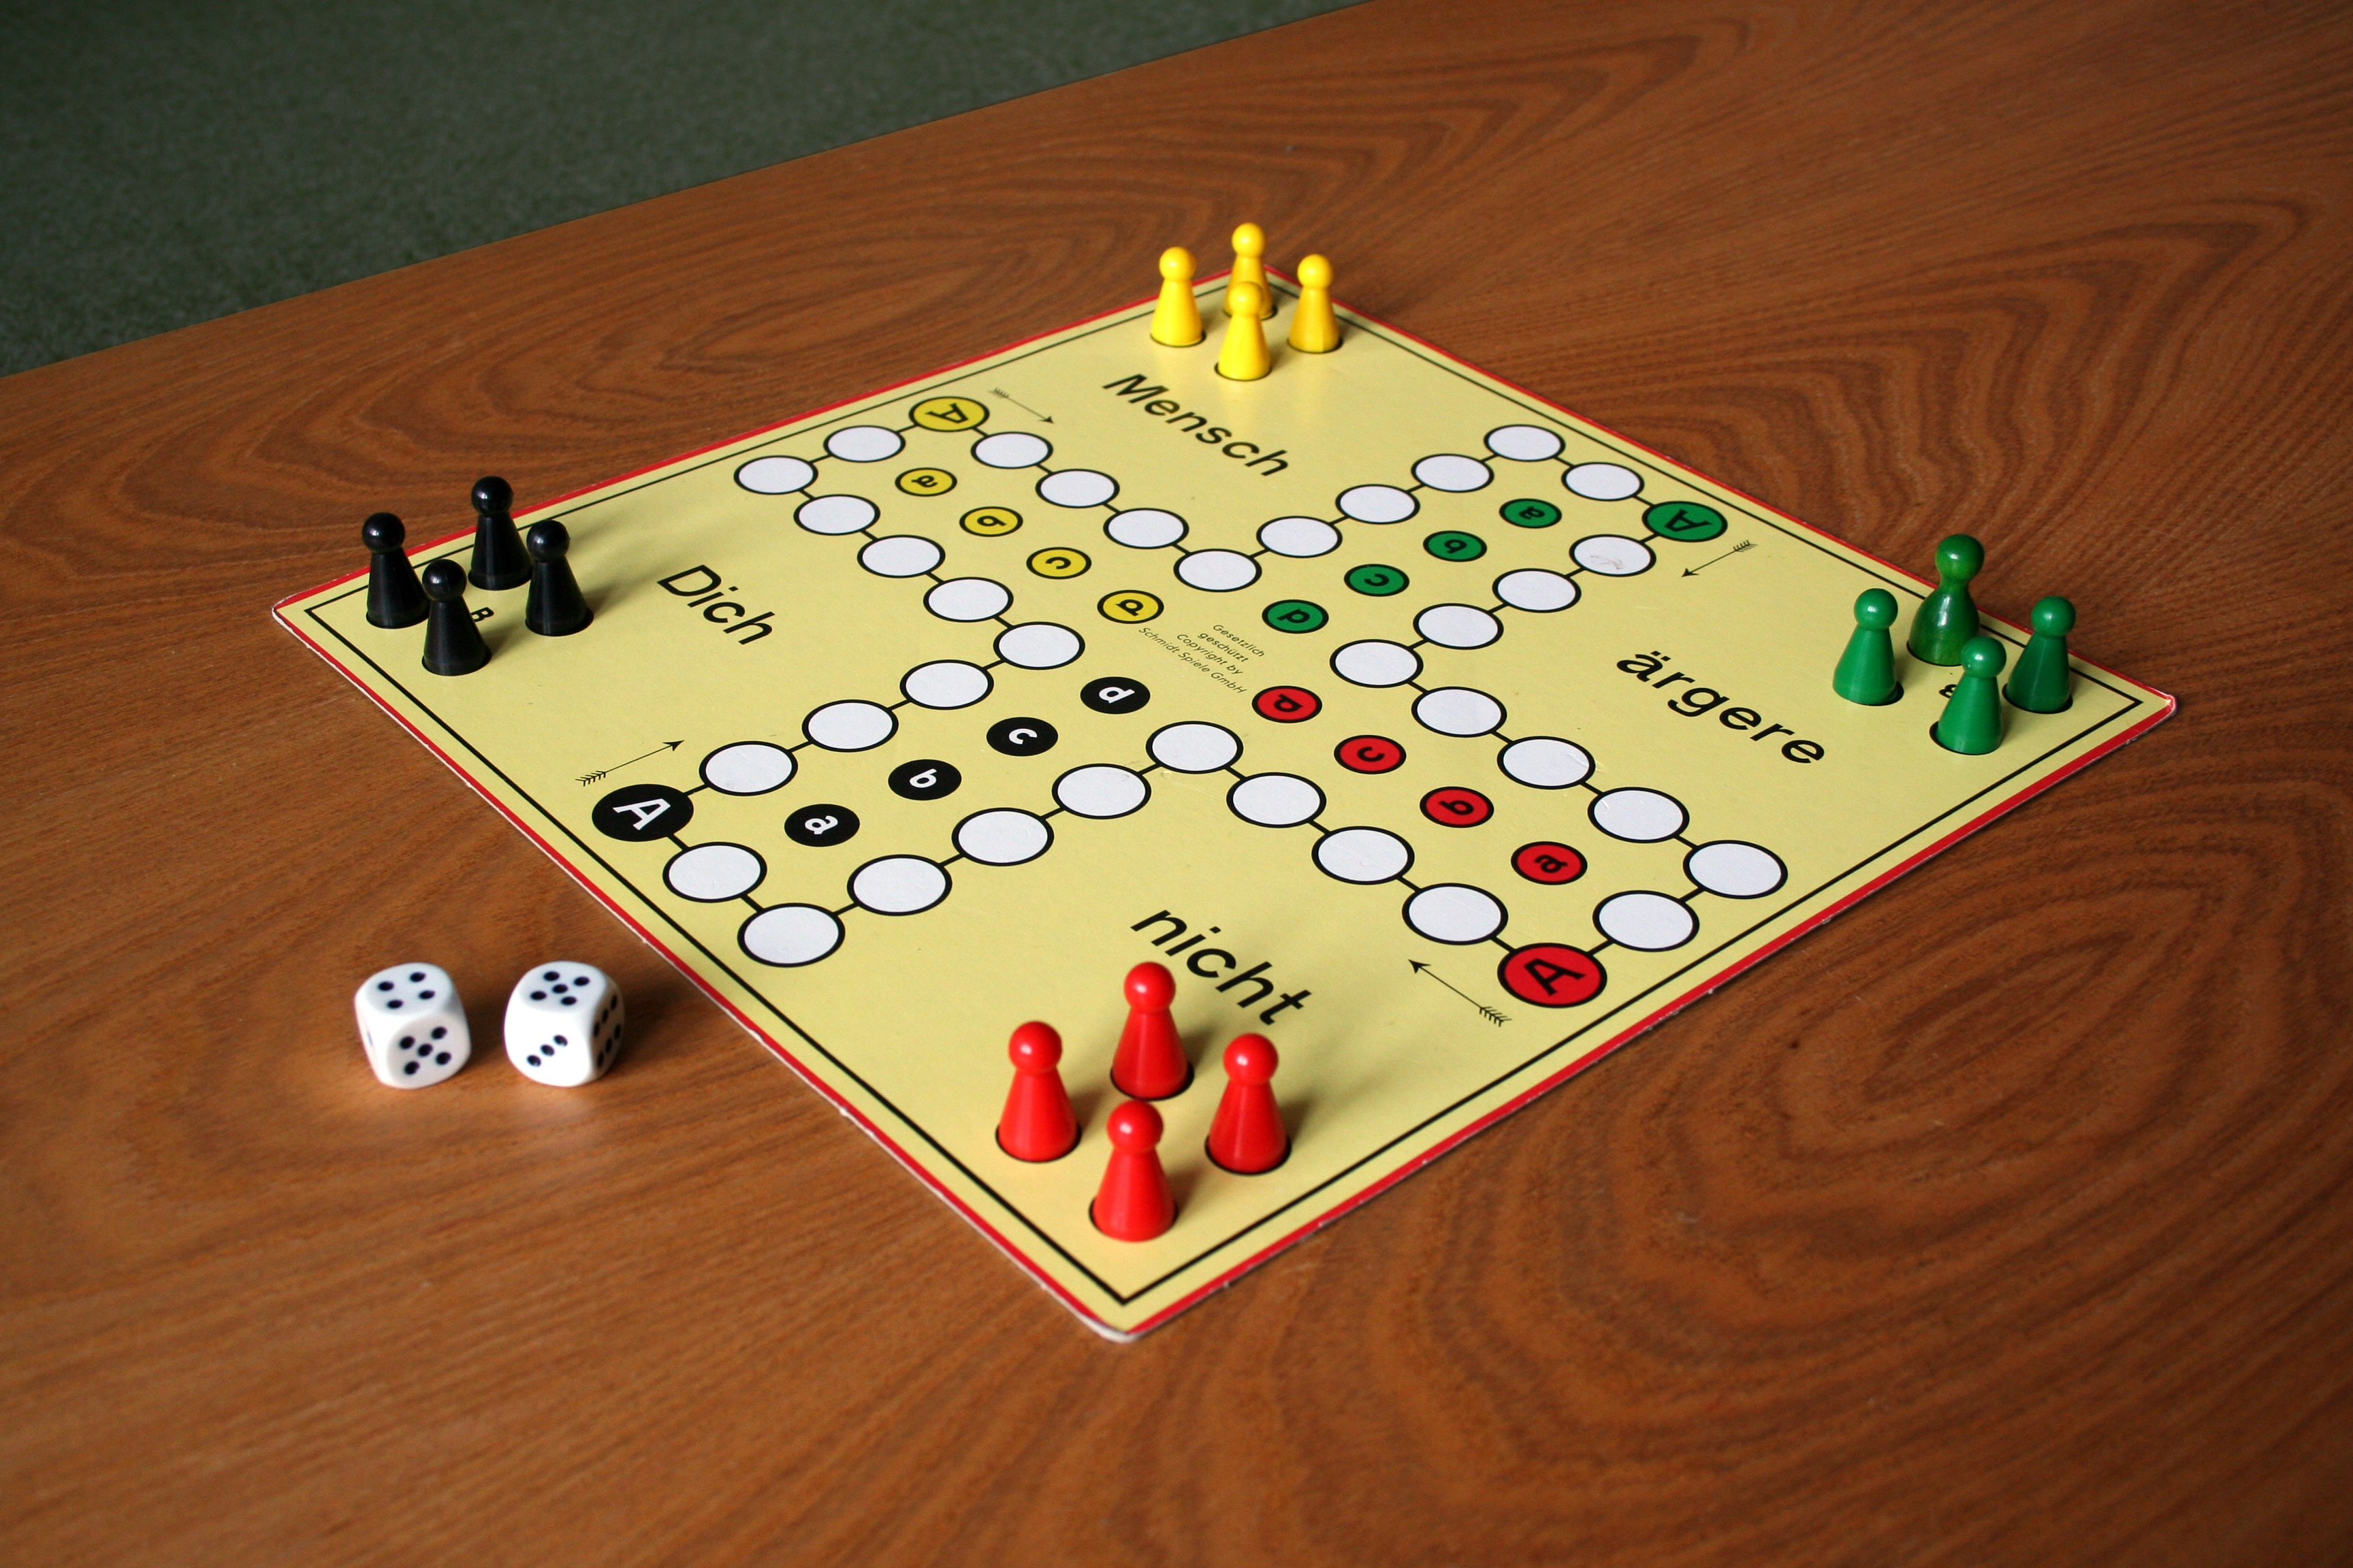
Introduction
There are assumptions at GameCo organisations that sales for the various geographic regions have stayed the same over time. The international sales records describe that the sales varied by geographic region and year.

Slide 4

Yearly Global sales

Slide 5
Global YEARLY performance
By Line, chart graph it is clear the total sales for the global sales have never stayed the same over the year. There were some high sales in some years and gradually reduced in following years.
Fig 1: Historical data points of total global sales.

Slide 6
Regional YEARLY performance
The overall difference in sales pitch demonstrates that the sales for the various geographic regions never stayed the same over time. Also, the performance in the sales varied over time.
Fig 2: Historical data points of yearly regional sales

Slide 7
Which region competing?

Slide 8
Overall revenue
Total North America’s proportion of global sales | 49%
Total Europe's proportion of global sales | 27%
Total Japan’s proportion of global sales | 15%
Total Japan’s proportion of global sales | 9%
Fig 3 Each region's proportion in global sales

Slide 9
Contribution to Global sales
North America’s proportion of global sales has reduced each year, and Europe has shown better progress in the proportion of global sales. But the total North American sale is the highest contributor to global sales by 49%.
In 2016, European sales surpassed North American sales by 6%. North America has contributed 32%, whereas Europe has contributed 38% to global sales.
From 1992 to 1996, Japan’s sales contributed more than the other regions in global sales.
Since 1996, other regions’ sales have continuously increased compared to previous years.

Slide 10
Which Games are played most?

Slide 11
Effect of the genre in each region
The most popular games in North America, Europe and Japan are Action, Sports and shooter games. Still, action games are the highest played in the region with total revenue of 861.8 million.
Role-playing games in Japan generated a higher global sales revenue in 1996, and these games were highly played in the region.
The minor revenue maker games are Puzzle, Adventure, Strategy games.
Platform games are also making a more considerable contribution to global revenue.
Fig 3 Total sales in the genre

Slide 12
Why geographic sales varied over time?

Slide 13
Correlation
The total number of games published and global sales positively correlate. It is clear from the line graph that the higher the number of games published, the higher the sales.
Fig 4.1 Yearly global sales and the number of games published
Fig 4.2 Correlation between the number of games published vs global sale

Slide 14
Correlation
From 1994 to 2009, sales consistently increased in all regions, and the number of games published during the years had similar growth.
The number of games published by Nintendo is 696, which is fewer games compared to other publishers and earning total global sales of 1784.43 million are the highest.
The number of games published in 2008 and 2009 is 1422 and 1425, respectively. Most genre games were action, sports and miscellaneous games.
Total number of games from 1980 to 1993 is 365. Which shows the lowest sales graph of all time.

Slide 15
Conclusion

Slide 16
summary
Historical data points in the line chart show that global and regional sales never stayed consistent.
All regional sales contributions to global sales varied over the years.
Regional sales value affected over time depending on the type of game played(genre). Action, Shooting and Sports games were sold more than the rest of the genre.
International sales figures changed over time in the number of games published. Higher the number of games publications, the higher the global sales.

Slide 17

Action Points

Slide 18
Leadings
Distribution of marketing resources shouldn’t be the same over the years. Or it shouldn’t be correlated with sales value.
Regional sales value is affected by the type of publication, genre and platform the games are played on. Distributing marketing resources on these criteria may lead to higher sales.
Shipping dates could be the possibility for the lower sale values in other regions. Online access/streaming of the games could generate faster revenue.
The lower-sale genre games like puzzle, adventure, and strategy games require more marketing.

Slide 19

Thank you
Muhammad Abdulkayyum​ Muttaki

